Slide 1
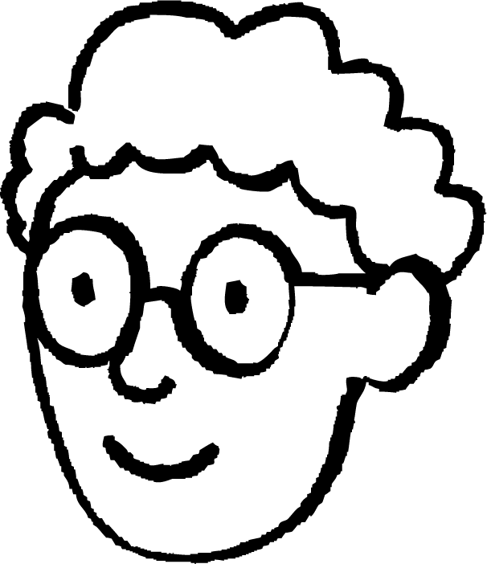
Introduction to enlargements
Task A: Understanding enlargement
1) Write true or false for each statement.
a) Enlargement only refers to when a shape increases in size.
False
b) The image may have different lengths to the object after an enlargement.
True
c) The image may have different angles to the object after an enlargement.
False
d) The image can be smaller than object after an enlargement.
True
2) Alex is going to enlarge the parallelogram to double the size.
35°
He thinks that the corresponding angle in the image will be 70°.
Do you think he is correct? Justify your answer.
No, Alex is not correct because…
enlarging a shape does not cause the angles to change size
the corresponding angle will be 35°

Slide 2
Introduction to enlargements
Task B: Understanding similarity
1) Match the rectangles which are similar.
1 cm
3 cm
6 cm
4 cm
12 cm
10 cm
4 cm
12 cm
8 cm
2 cm
16 cm
5 cm
2) Use square paper to accurately draw the right-angled triangle below.
a) Draw another right-angled triangle that is similar to this one.
The base and height should be pairs of numbers obtained by multiplying 4 and 3 by the same number. Examples: 8 and 6, 12 and 9, 16 and 12, 20 and 15, 2 and 1.5
b) Cut out each triangle. Place one triangle on top of the other and match up one of the vertices. What do you notice?
Corresponding angles are equal.
Mathematics in Education and Industry
v2.2

